Slide 1
OTC Pricing Procedure

Slide 2
Lesson Objectives
  Pricing
  Purpose
  Use
  Challenges
Pricing in SAP
  Pricing Relevance in Order, Delivery & Billing
  Pricing - Condition Technique
  Condition Table
  Condition Table – Configuration
  Access Sequence
  Access Sequence – Configuration
  Condition Type
  Condition Type – Configuration
  Pricing Procedure
  Pricing Procedure – Configuration
  Pricing Procedure – Determination
Notes:
Add instructor notes here.

Slide 3
Lesson Objectives
  Pricing Relevant Customer Master Data Fields
  Pricing Relevant Sales Document Fields
  Pricing Relevant Data Fields - In Order
  Condition Record
  Condition Record – Create
  Condition Record – Create: Header Details
  Condition Record – Create: Details
  Condition Record – Create: Additional Sales Data
  Condition Record – Create: Scales
  Condition Record – Change
  Some important Fiori apps
  Transaction Codes
  Steps
  Tips and Tricks
  Additional Info
Notes:
Add instructor notes here.

Slide 4

What is Pricing?
Pricing is the manual or automatic process of applying prices to sales orders, based on factors such as: a fixed amount, quantity break, promotion or sales campaign, price prevailing on entry, shipment or invoice date, combination of multiple orders or lines, and many others

Slide 5


Purpose
The business is faced with many alternatives to base the price of a product depending upon the specific conditions prevailing at the time of the sale
The effective price is the price the company sells its products after accounting for discounts, promotions, and other surcharges
The business needs to take into account many factors based on its products, customers, volume of sales, validity, competition, etc while deciding the pricing elements which altogether makes the task most crucial and complex

Slide 6

Use
  Pricing primarily helps in profit maximization and sustenance of competitive advantage in the market
  Pricing helps the users in assigning right value to the products being sold
  Pricing enables the users to fix prices dynamically for any changes in the quantities, time and place of payments, time and place of transfer of ownerships, etc.

Slide 7

Challenges
  At what prices the products should be sold?
  Is pricing the same for all the customers?
  Is pricing the same for all the materials?
  Is pricing the same for single and bulk quantities?
  Does price vary with geographical location?
  What are the taxes applicable for the sale?
  How much freight should be charged?
  What discounts are available?
  Which promotional offers are available?
  How long are these prices valid?
  When and for which products the prices have to be revaluated?

Slide 8
Pricing in SAP
During pricing, the system calculates amounts based on a combination of automatic
procedures & manually entered data.
The system uses Pricing Condition Technique to determine pricing. The condition technique refers to the method by which the system determines prices from information stored in
condition records.
Condition technique consists of:
  Pricing Procedure which consists of sequentially arranged condition types
  Pricing Condition Types determines the behavior of the pricing conditions and has access sequence assigned to it
  Access Sequence in turn decides the strategy, the system uses to search valid data among the condition tables assigned to it
  Condition table defines key fields of the condition records
  Condition record holds the actual data for the condition type

Slide 9
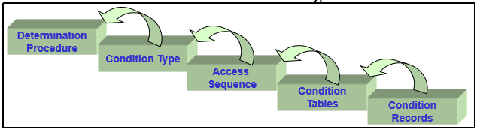
Pricing in SAP

Slide 10
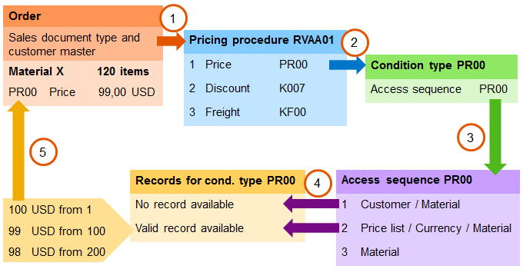
Pricing Relevance in Order, Delivery & Billing
The pricing is automatically copied from sales document to delivery document and billing document
Pricing Behavior in the documents can be controlled by configuring Pricing Type function which specifies how the system treats data when copying from documents. These functions are supported for both the sales and billing documents
However the prices can be re-determined in the billing document by configuring pricing type in the copy control function

Slide 11
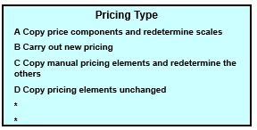
Pricing Relevance in Order, Delivery & Billing
ZZZZ Order
Net Value: $100
ZZZ Delivery
Net Value: $100
ZZ Invoice
Net Value: $100
Determining the pricing type in copying control for the item

Slide 12
Pricing - Condition Technique

Slide 13
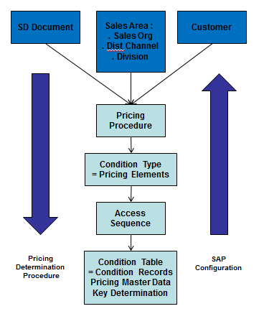
Pricing - Condition Technique
Condition Technique is a technique used by the system to choice among alternatives
Conditions represent a set of circumstances that apply when a price is to be calculated
SAP makes the choice based on conditions thereby determining which value to use under which circumstances or conditions
The primary elements of pricing condition technique are:
        Pricing Condition Records
        Pricing Condition Table
        Access Sequence
        Pricing Condition Type
        Pricing Procedure Determination

Slide 14
Pricing - Condition Technique
Condition Tables - Condition table is set of fields and condition records
Condition Records - Condition records are the actual value for the condition types
Condition Tables:
304 Material
305 Customer/material
900 Customer
Condition Records:
Sales Org CGSO
Dist 10
Customer 3412
Material
Description
Price
M-0001
XXXX
1000
M-1000
XXXX
1500

Slide 15
Pricing - Condition Technique
Access Sequence - is a sequential search strategy to find a valid condition record for a valid condition type
Access Sequence is assigned to each condition type and enables the SAP system to search the data from the most specific condition record to the most general condition record. It establishes which condition records have priority over others
305 Customer/material
306 Price List Type/Currency/Material
General
304 Material
Access Sequence PR02
Specific

Slide 16
Pricing - Condition Technique
Condition Type - All relevant Conditions are grouped together as Condition Types and determined as to how they are to function while pricing the products
All of the pricing elements that are used in the day-to-day pricing procedures - the prices, surcharges, discounts, freight charges, and taxes - are defined in the R/3 system as condition types
Condition Type
Description
Control Data
PROO
Price
K007
Discount %
Calculation Type
As a Percentage
Scale Basis
Quantity
K029
Discount/Weight
Calculation Type
Amount/Weight
Scale Basis
Weight
Example 1
Example 2
K007
Scale Basis Calculation Type
100 PCs 1.5 - %
10,000 PCs 2.0 - %
100,000 PCs 3.0 - %
K029
Scale Basis Calculation Type
1,000 lbs. USD 0.50 - per 1lb
10,000 lbs. USD 1.00 -
40,000 lbs. USD 1.50 -

Slide 17
Pricing - Condition Technique
Price Procedure Determination - A Pricing procedure consists of a list of condition types in a defined order, such as price, less discount, plus tax
Ex: SAP must find a price for a product, but a number of price conditions can exist for the product. There could be the list price that applies to that group of products, a special price for that customer, or a specific price for that product
Condition
Types
Access
Sequence
Procedure
Condition
Tables
Condition
Records

Slide 18

Pricing - Condition Technique
Pricing Procedure: ZZZZZZ
Step
Condition Type
Description
OR - Sales Order
Customer : 6
Sales Area : 3000,01,10
Price List Type : RT
1
PR00
Price
XYZ
PR00 1 EA 100USD
2
K005
Discount/UOM
3
K007
% Discount
Condition Type: PR00
Conditional Record
3000/01/10
RT/XYZ
From 1 - 499 100 USD
500 - 599 90 USD
1000 - . . . 80 USD
Access sequence: PR02
1. Customer/material
2. Price list/material
3. Material
No Record Found

Slide 19
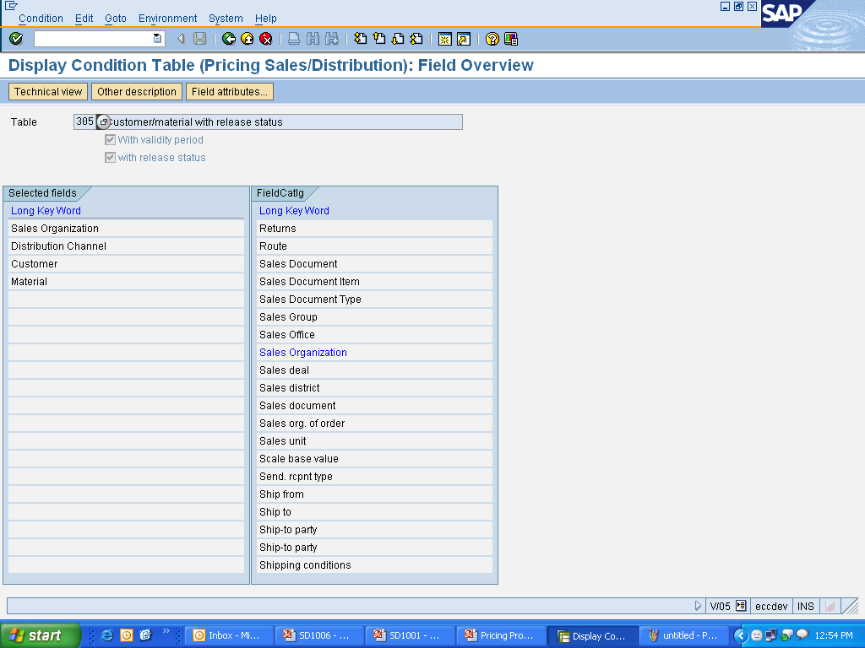
Condition Table
Condition table is a set of conditions/fields (key fields) and condition records. The condition table is created by selecting the fields from the field catalog
The fields from which you can make your selection are called the allowed fields.
The fields that you choose to make up the key are called the selected fields
Menu path: IMG → Sales and Distribution → Basic functions → Pricing → Pricing Control → Define Condition table.
T-code: V/03

Slide 20
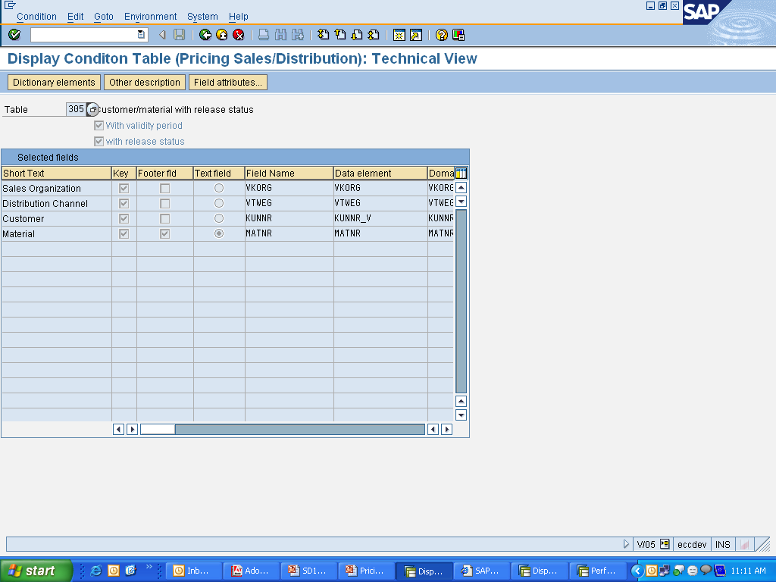
Condition Table - Configuration
Header Line Fields
contain information general to all item line fields
Footer/ Item Line Field
for which the actual value is maintained

Slide 21
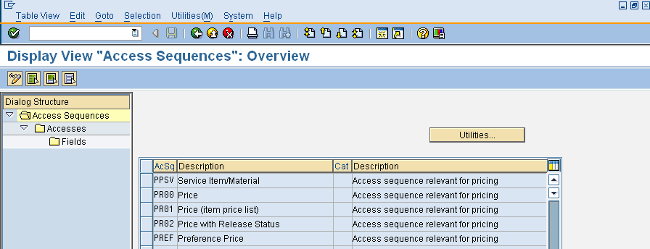
Access Sequence
Access sequence- The access sequence enables the system to access the condition data records in a particular sequence until it finds a valid data
Menu Path: IMG → Sales and Distribution → Basic functions → Pricing → Pricing Control → Define Access Sequence.
T-code: V/07

Slide 22
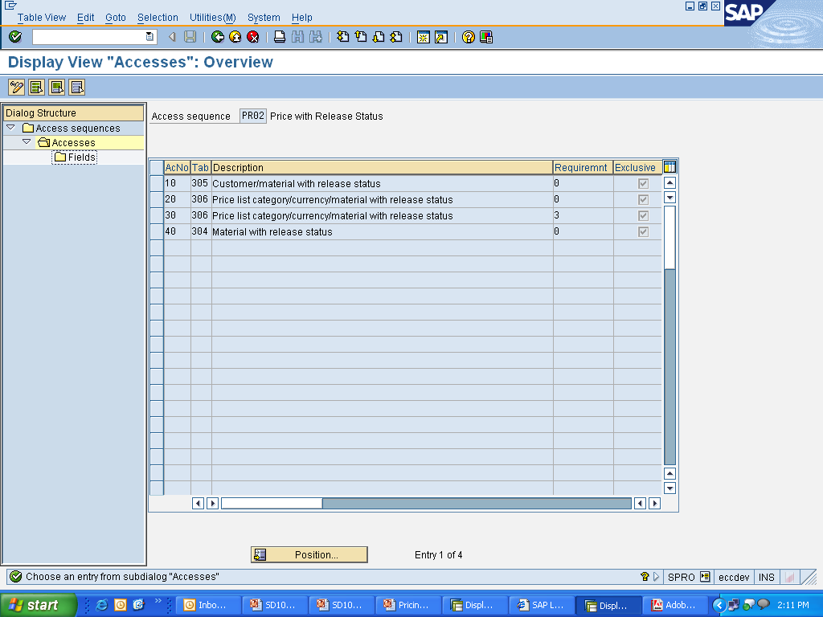
Access Sequence - Configuration
Access Sequence consists of accesses which specifies the access number or the sequence in which the system searches the condition tables for the required data. Requirement can be specified for each condition table thereby ensuring system access that condition record only on fulfillment of certain conditions. Activation of exclusive indicator limits the access to the first match.

Slide 23
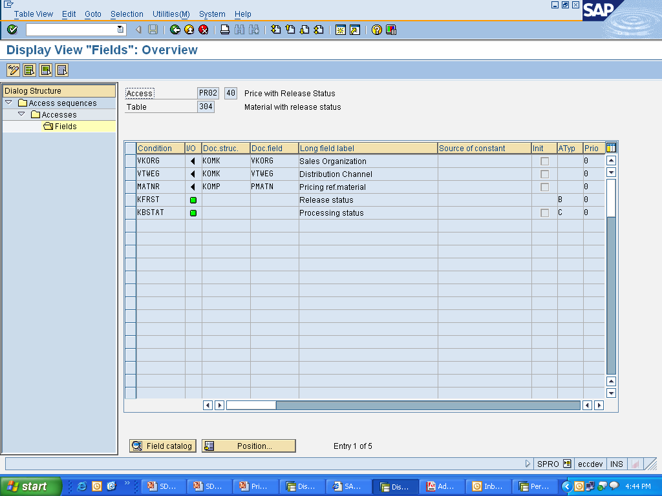
Access Sequence - Configuration
The access sequence refers to the fields which are relevant for pricing using the condition tables contained in the access sequence

Slide 24
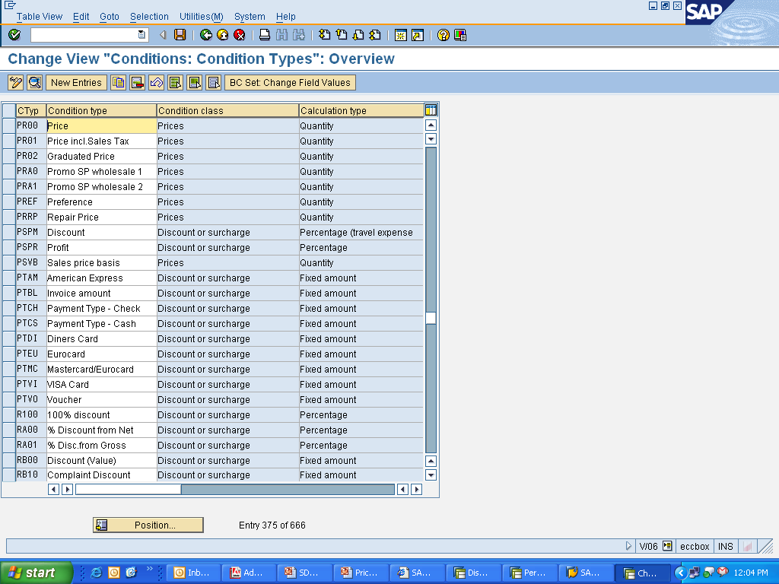
Condition Type
Condition type is a group of relevant conditions. It tells the behavior of a record
Menu Path: IMG → Sales and Distribution → Basic functions → Pricing → Pricing Control → Define Condition type.
T-code: V/06

Slide 25
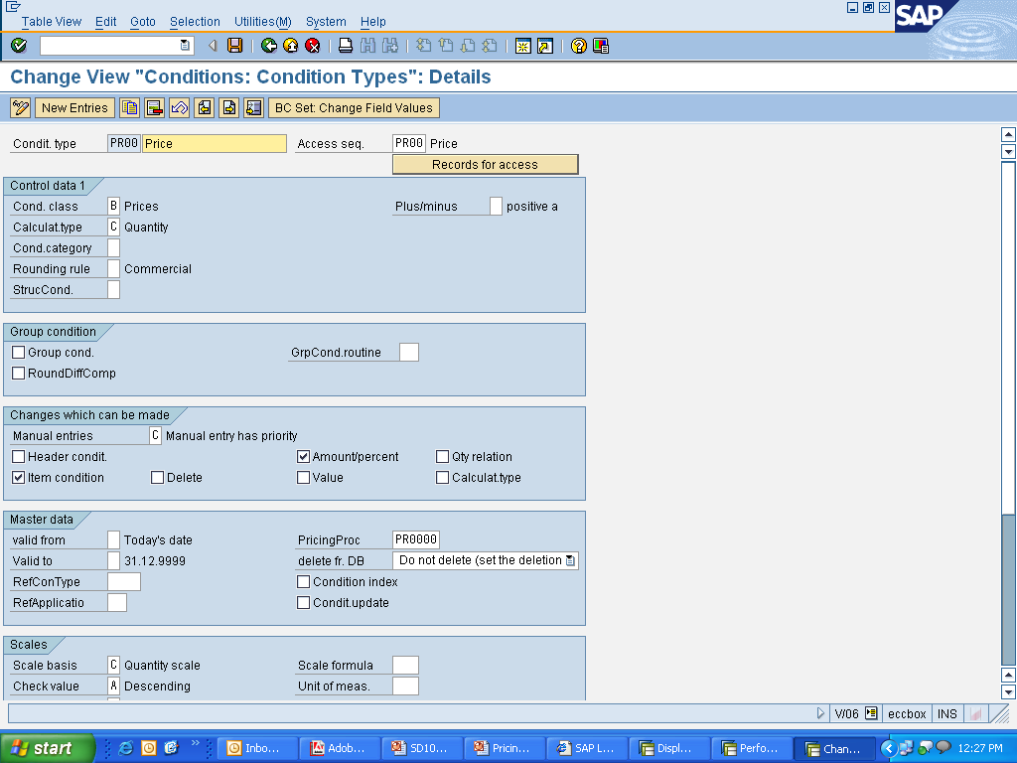
Condition Type - Configuration
Various control parameters are defined for each condition type, which determines its behavior while pricing
Basic grouping of Condition Types as Prices, Discounts/surcharges, etc
Determines if the condition value is to be treated as value or percentage
Access Sequence is assigned here
Determines if the condition value has a +/- effect on pricing
Determines how the system rounds off condition values
Determines if the scale value is derived from several line items in the order
Determines if the condition type is relevant for cumulation of values

Slide 26
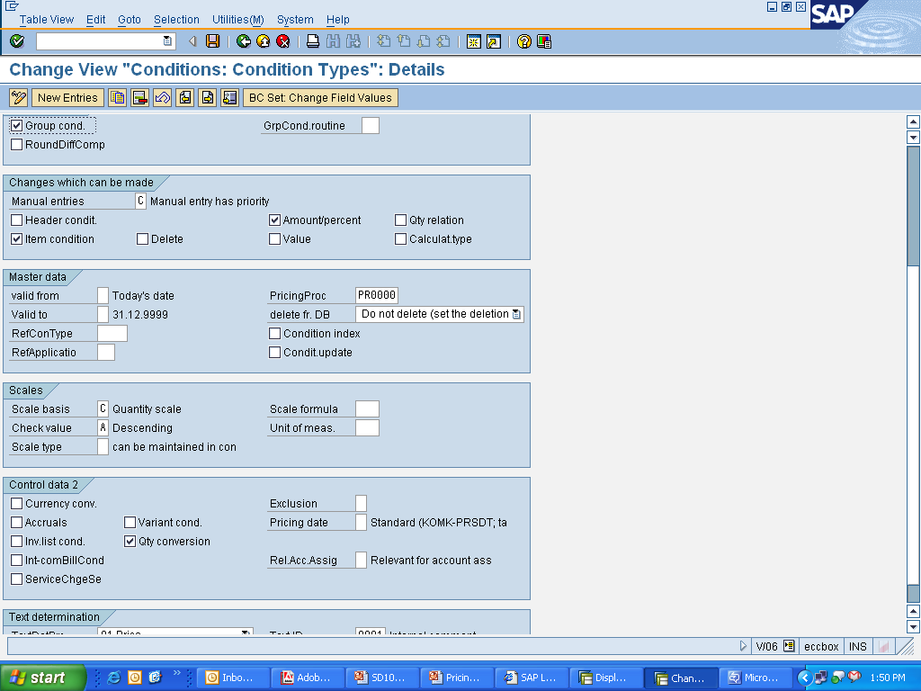
Condition Type - Configuration
Determines if the condition type is relevant for header or item pricing
Controls the changes permitted for the Condition Type value
Determines if Manual changes are allowed
Controls if Condition Type can be deleted
Specifies the validity period of the condition Type
Specifies the validity period of the condition Type
Notes:
The tab Changes which can be made has those parameters which control the changes permitted for the condition type values while processing the sales document.

Slide 27
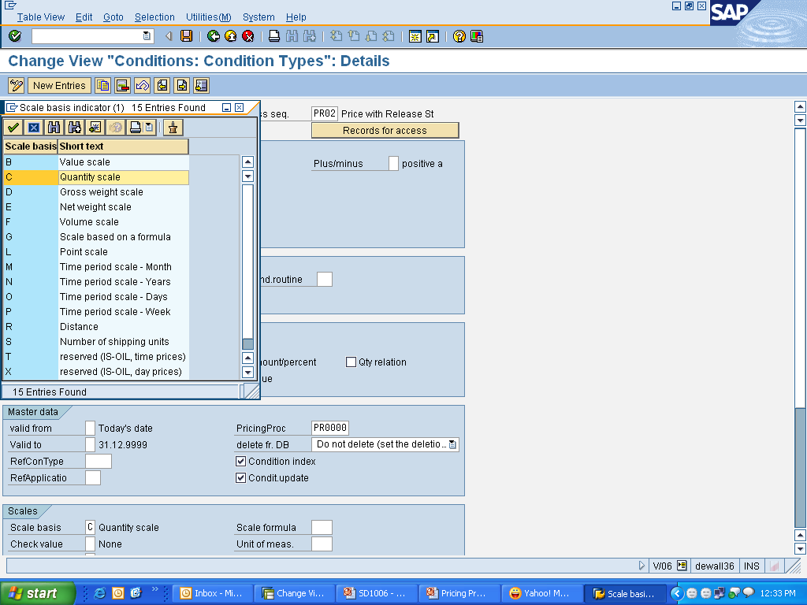
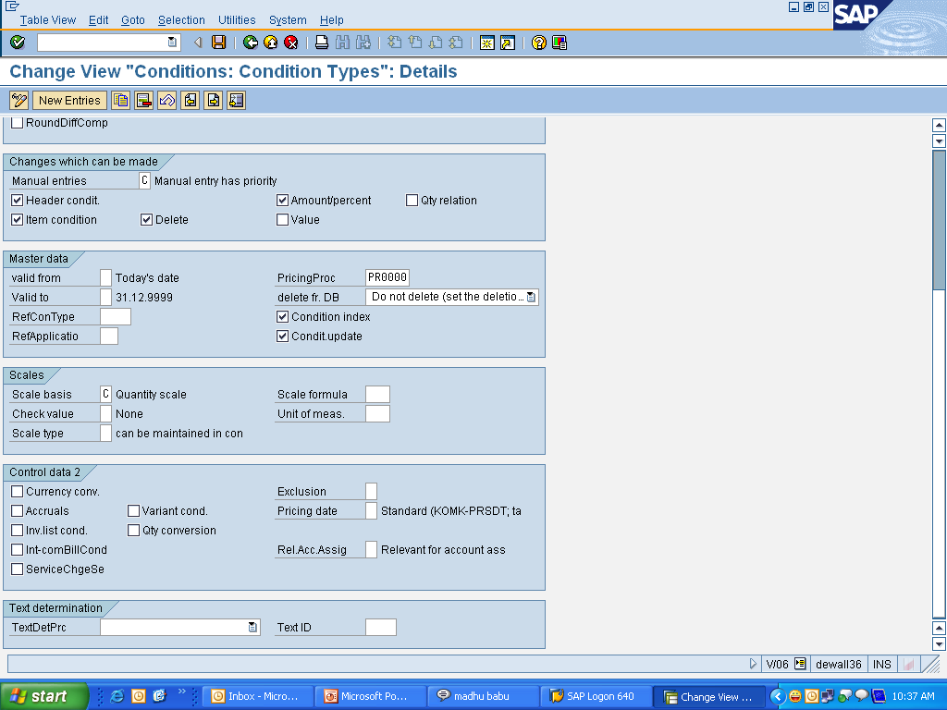
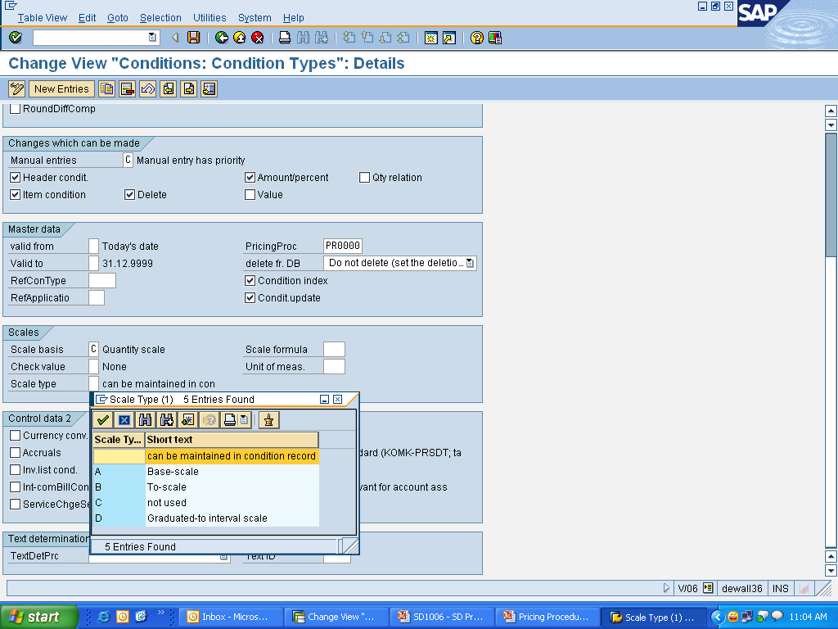
Condition Type - Configuration
Determines if the scales are to be treated as value or quantity based
Controls if the scales should always be entered ascending or descending
Controls the range of scale values

Slide 28
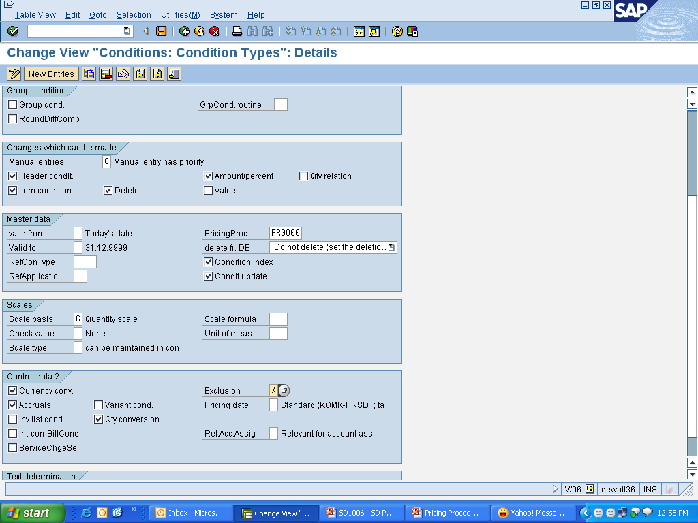
Condition Type - Configuration
Controls Currency Conversion in cases where Doc. currency varies from that in the condition record
Defines the date from which the Condition type is to be calculated in the sales document
Excludes all records of this Condition Type
Allows to post the condition value to Financial Accounting as accruals
Allows quantity conversion during determination of condition basis

Slide 29
Pricing Procedure

Slide 30
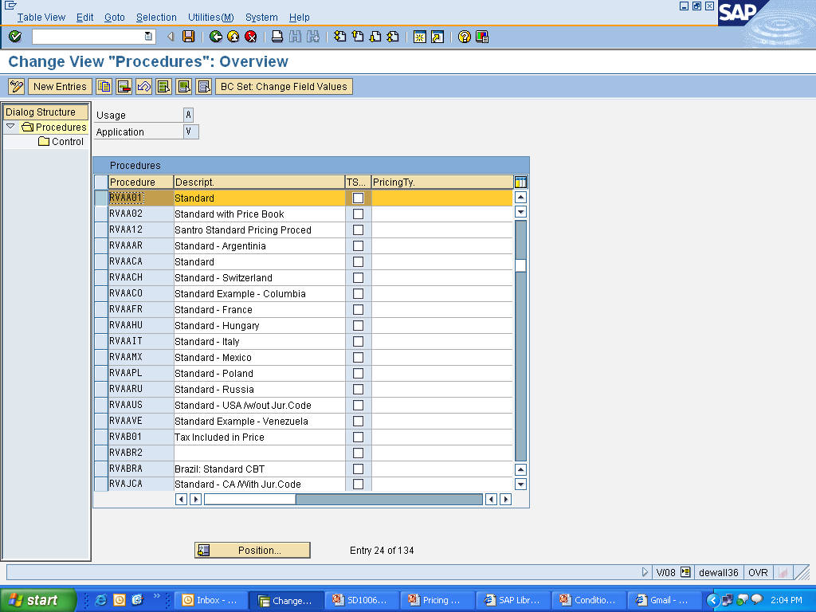
Pricing Procedure
Menu Path: IMG → Sales and Distribution → Basic Functions → Pricing → Pricing Control → Define and assign Pricing Procedure. T-Code: V/08

Slide 31
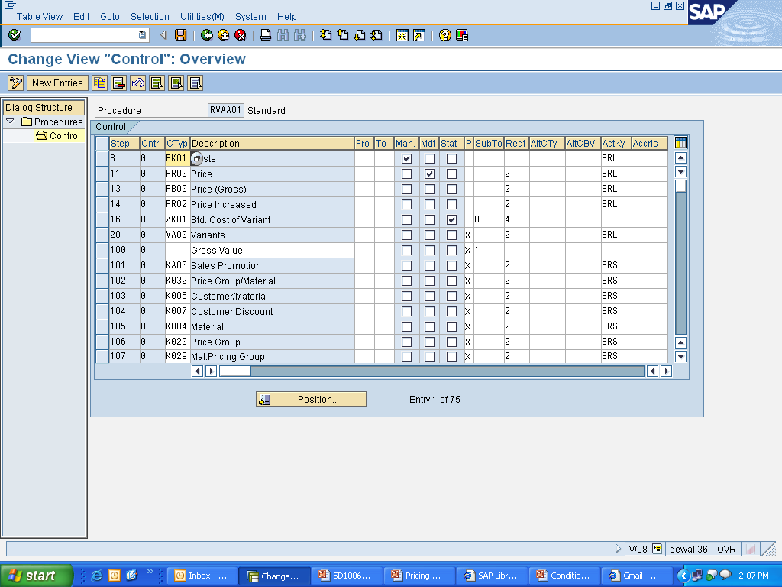
Pricing Procedure - Configuration
Pricing Procedure consists of a group of allowed condition types placed in the sequence of their execution

Slide 32
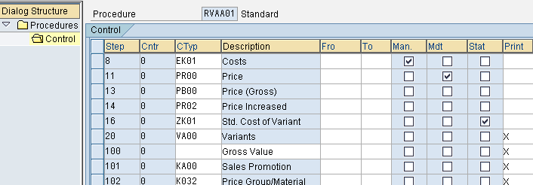
Pricing Procedure - Configuration
Step : Determines the sequence of the condition Types
Counter: Determines the sequence of the condition Types within a step
From & To : Defines the basis and range for calculation of Condition Types (%)
Mandatory : Indicates if the Condition Type is mandatory while pricing
Manual : Allows manual entry of condition value in the sales document while pricing
Statistical : Controls the condition value effect on the net total calculation of the item

Slide 33
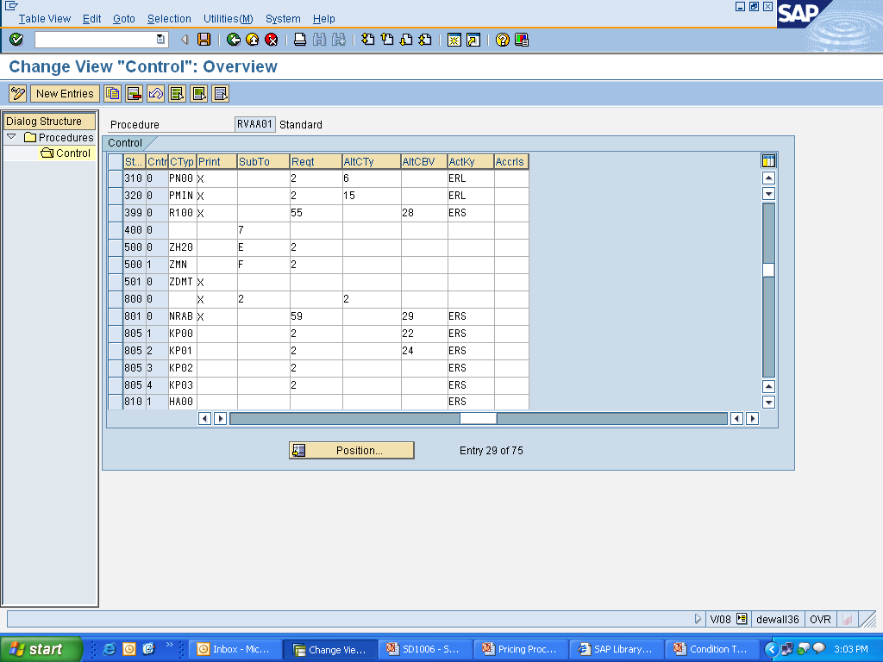
Pricing Procedure - Configuration
Print : Controls which condition lines are printed on the documents
Requirement : Excludes a condition type from being accessed
Alt. Cond. Base Value : Indicates formula for determining alternate condition base value
Accruals : Identifies the G/L accounts for accrual of condition values
Sub-total : Indicates fields in which the cumulative value of conds. are stored
Alt Calc Type : Indicates alternate formula to determine the cond value
Account Key : Identifies the G/L accounts for posting of cond. values

Slide 34
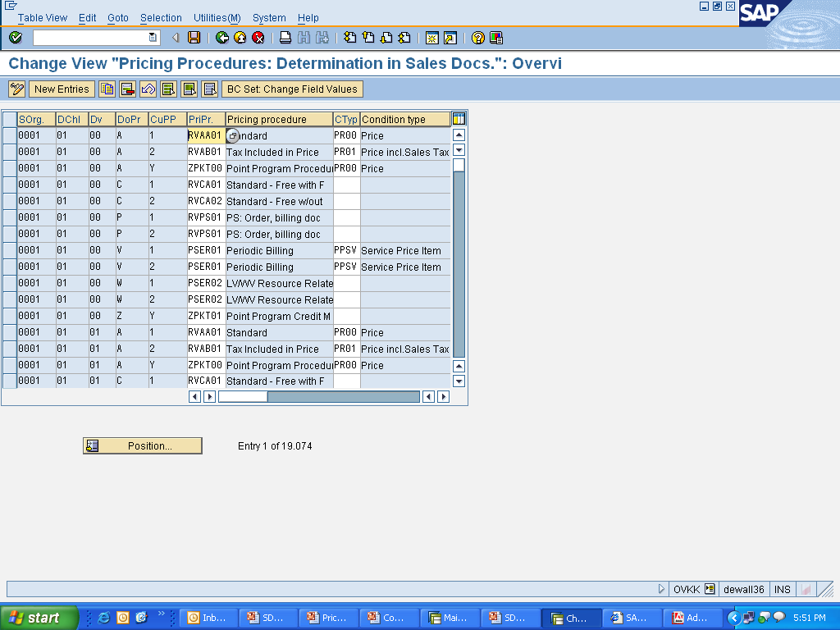
Pricing Procedure - Determination
Pricing Procedure is determined using:
  The Sales Area (sales organization, distribution channel, and division)
  The Document Pricing Procedure (DoPr) code from the document type
  The Customer Pricing Procedure (CuPP) code from the customer master record
Menu path: IMG → Sales and Distribution → Basic functions → Pricing → Pricing Control → Define and Assign Pricing Procedures → Define Pricing Procedure Determination
T-code: OVKK

Slide 35
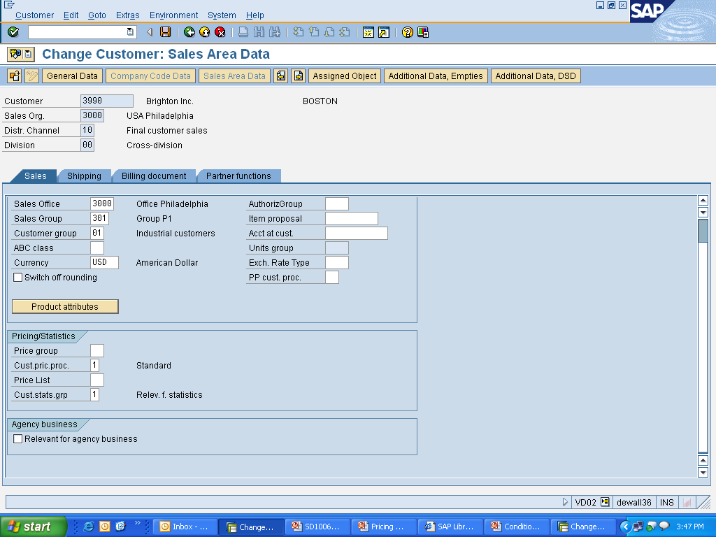
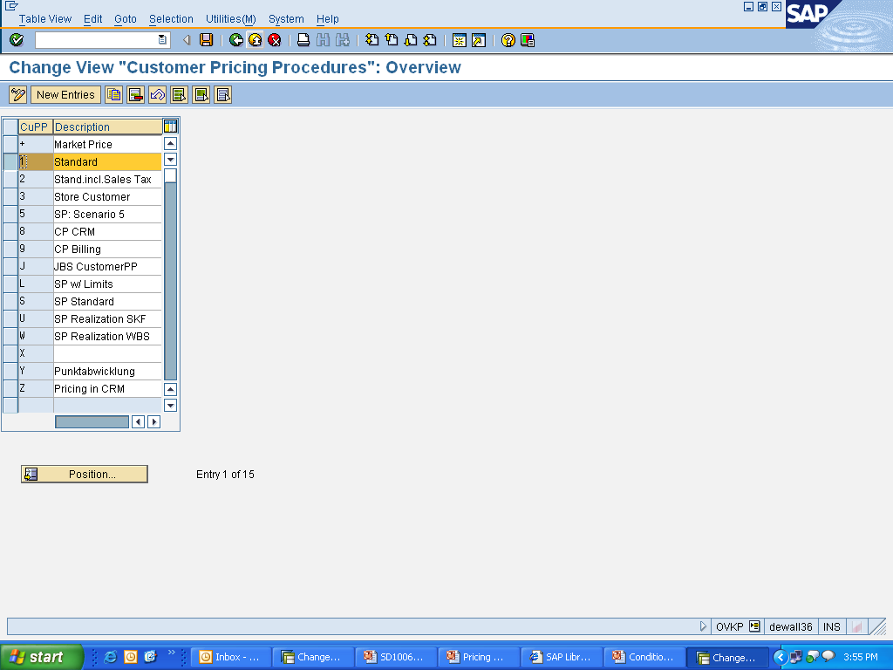
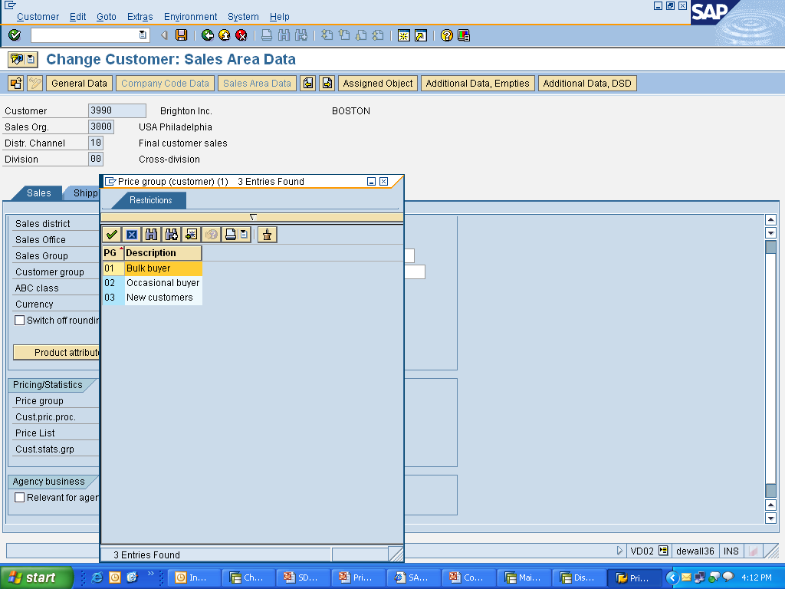
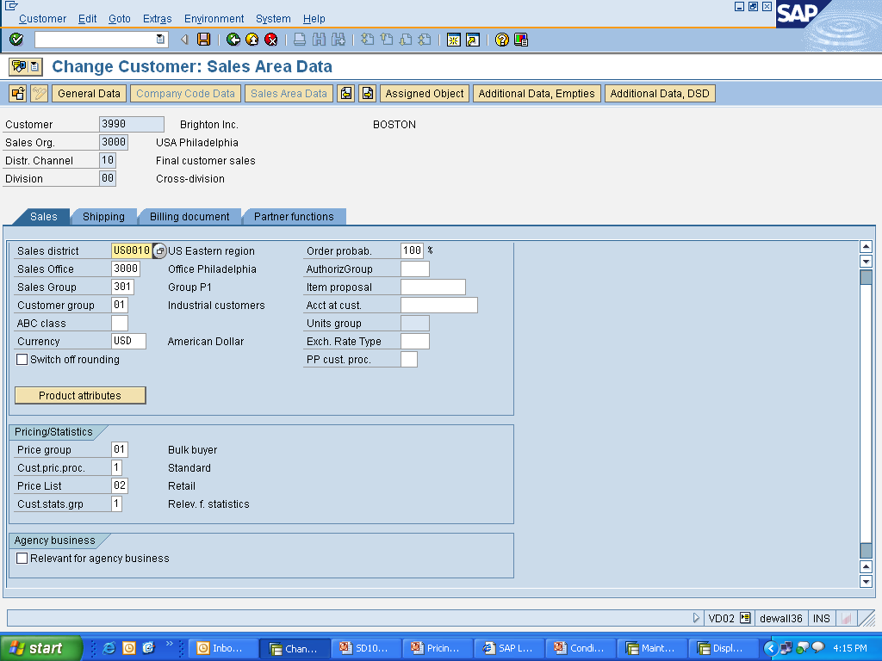
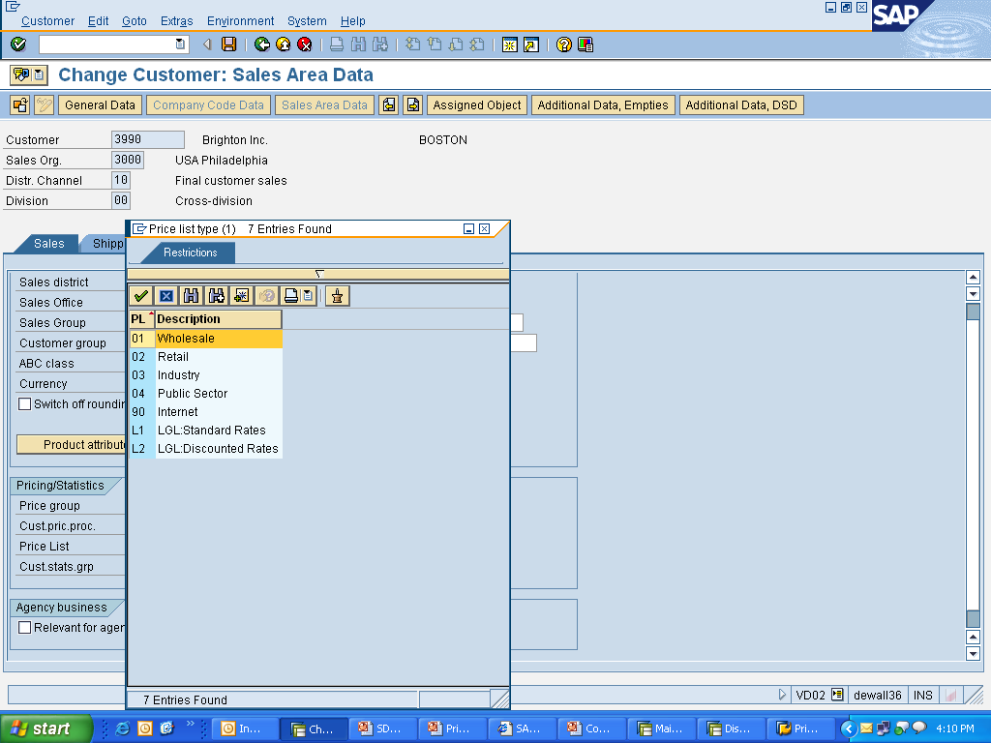
Pricing Relevant Customer Master Data Fields
Cust. Pricng Procedure : Determines the pricing procedure when creating sales doc.
Price Group : Grouping of customers with similar buying patterns
Price List : Grouping of customers with similar pricing requirements
T-Code: OVKP & VD02
Menu Path: IMG → Sales and Distribution → Basic Functions → Pricing → Maintain Price-Relevant Master Data Fields → Define Price List Categories for Cust. & Define Pricing Groups for Cust.
Notes:
Customer Master Data Fields are defined and then assigned to the Customer Master in the Sales Tab of Sales Area Data View.

Slide 36
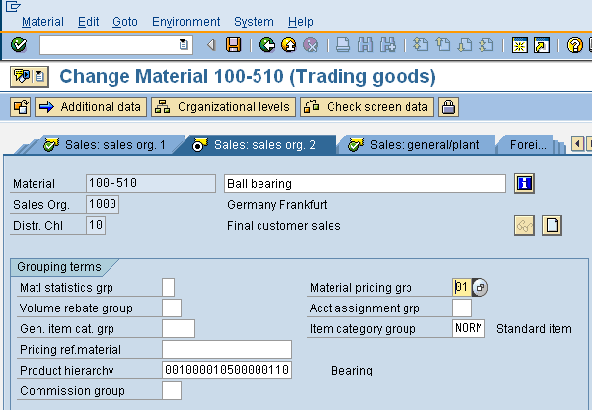
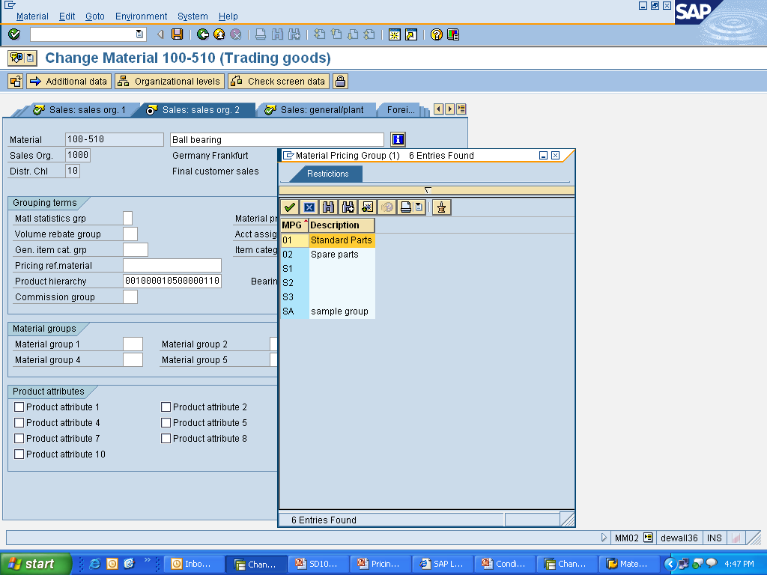
Pricing Relevant Material Master Data Fields
Material Pricing Group : Grouping Of material with similar pricing features
T-Code: MM02
Menu Path: IMG → Sales and Distribution → Basic Functions → Pricing → Maintain Price-Relevant Master Data Fields → Define Material Groups
Notes:
Material Master Data Fields are defined and then assigned to the Material Master in the Sales: sales org. 2 view.

Slide 37
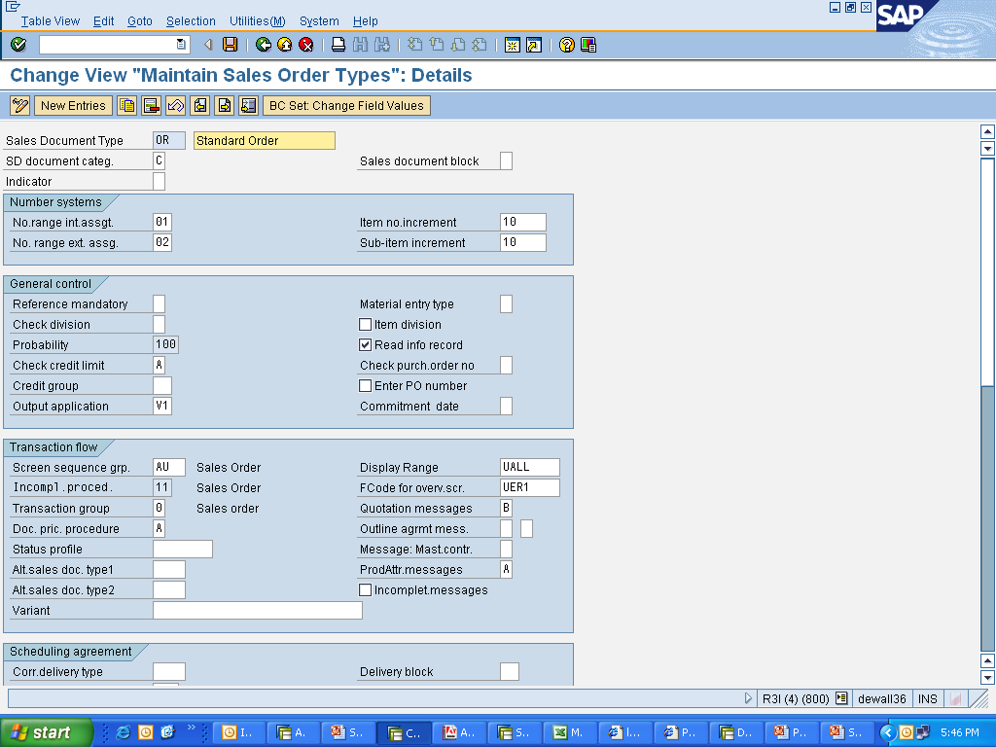
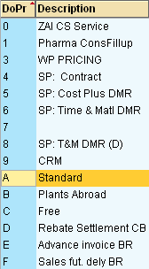
Pricing Relevant Sales Document Fields
Menu Path: IMG → Sales and Distribution → Basic Functions → Pricing → Pricing Control → Define and Assign Pricing Procedures→ Define Doc. Pricing Procedure & Assign Doc Pricing procedure to Order types
T Code: OVKI & OVKJ
Notes:
Material Master Data Fields are defined and then assigned to the Material Master in the Sales: sales org. 2 view.

Slide 38
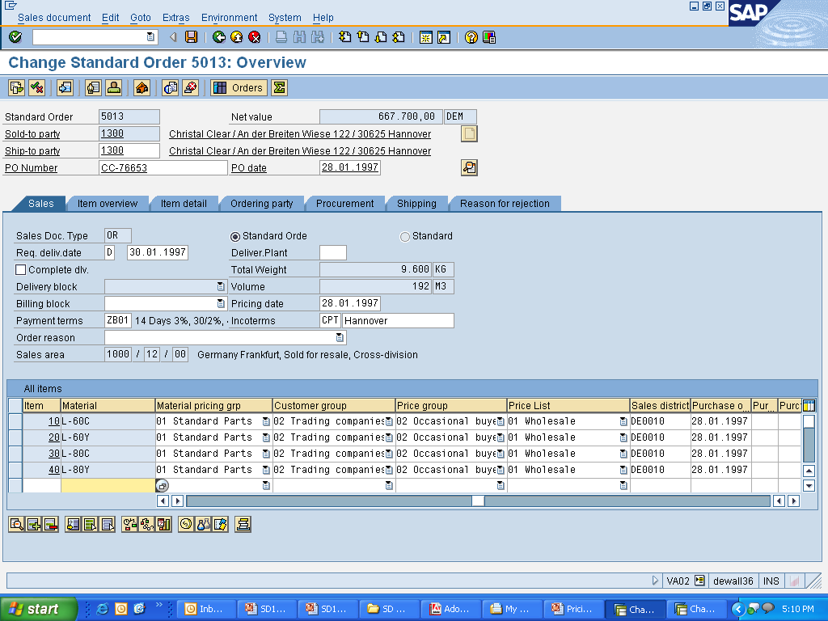
Pricing Relevant Data Fields - In Order

Slide 39
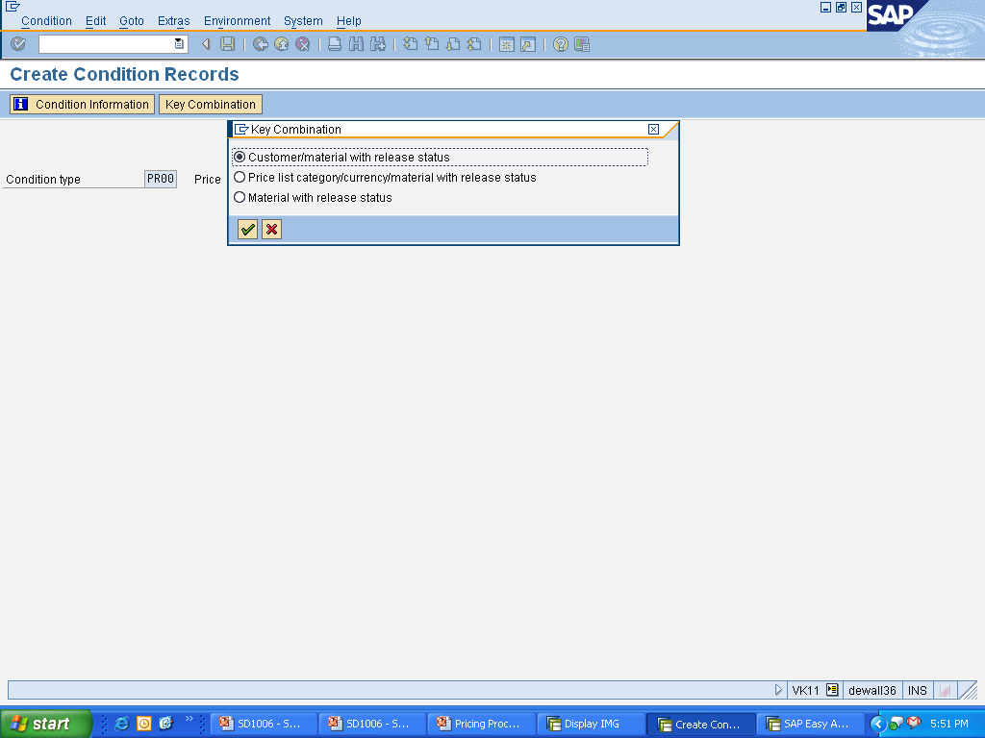
Condition Record - Create
They store the actual value for all the pricing elements
Menu Path: Easy Access →Logistics → Sales and Distribution → Master Data → Conditions → Select using Condition Type → Create (T-Code: VK11)
Condition Maintenance Menu Path: Easy Access →Logistics → Sales and Distribution → Master Data → Conditions → Create (T-Code: VK31)

Slide 40
Condition Record

Slide 41
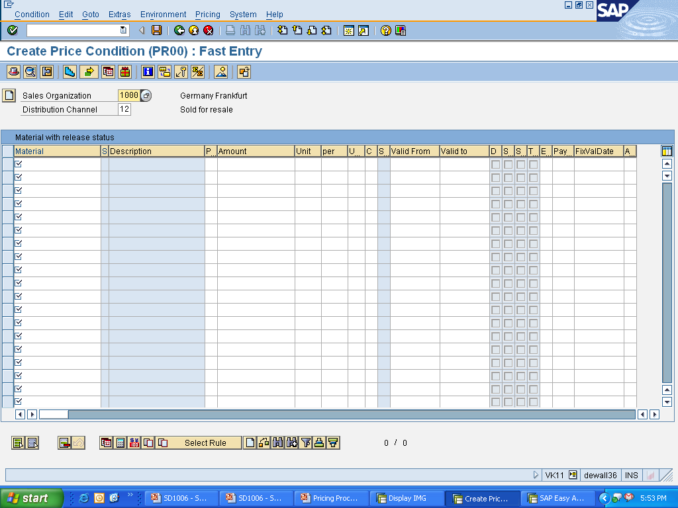
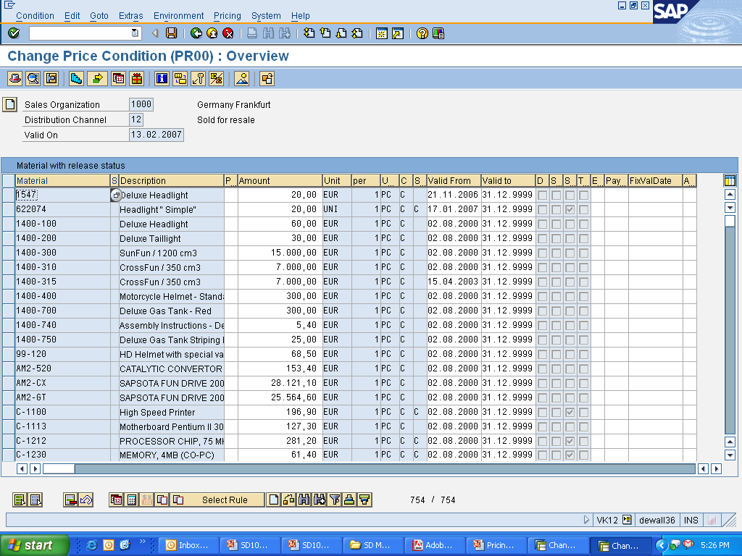
Condition Record - Create
Condition records can also be created with reference to those already having similar data but vary on accounts like validity period, etc. During the process, changes can be made to the rate, validity period, and additional sales data, etc

Slide 42
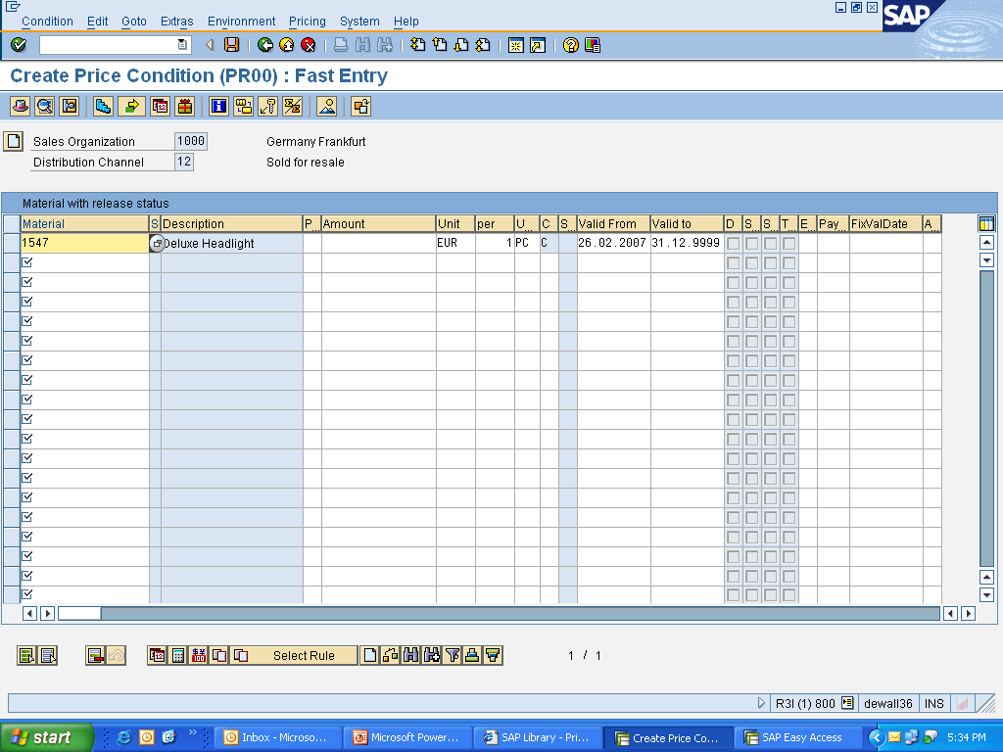
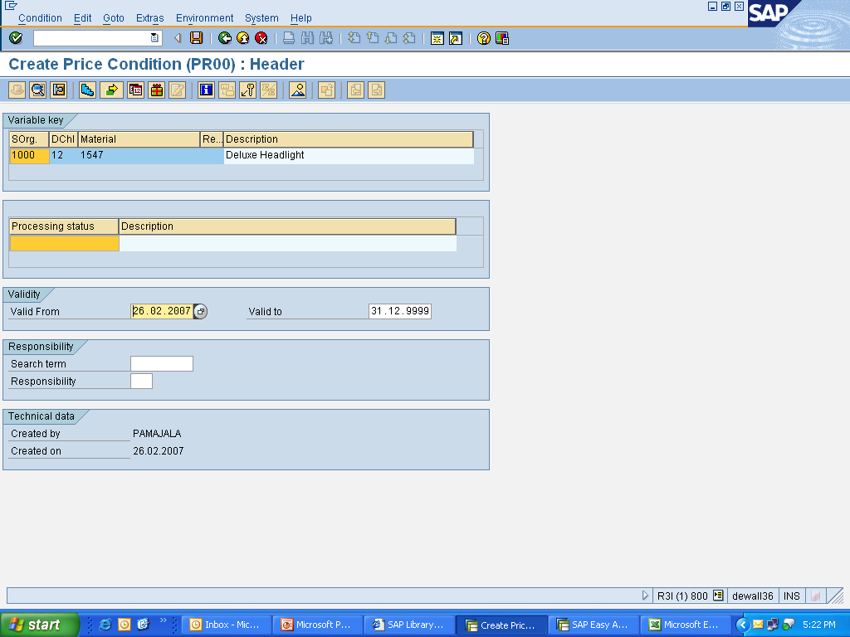
Condition Record – Create: Header Details
The header details of the condition record stores the validity period of that particular condition record and can be maintained only while creating the record

Slide 43
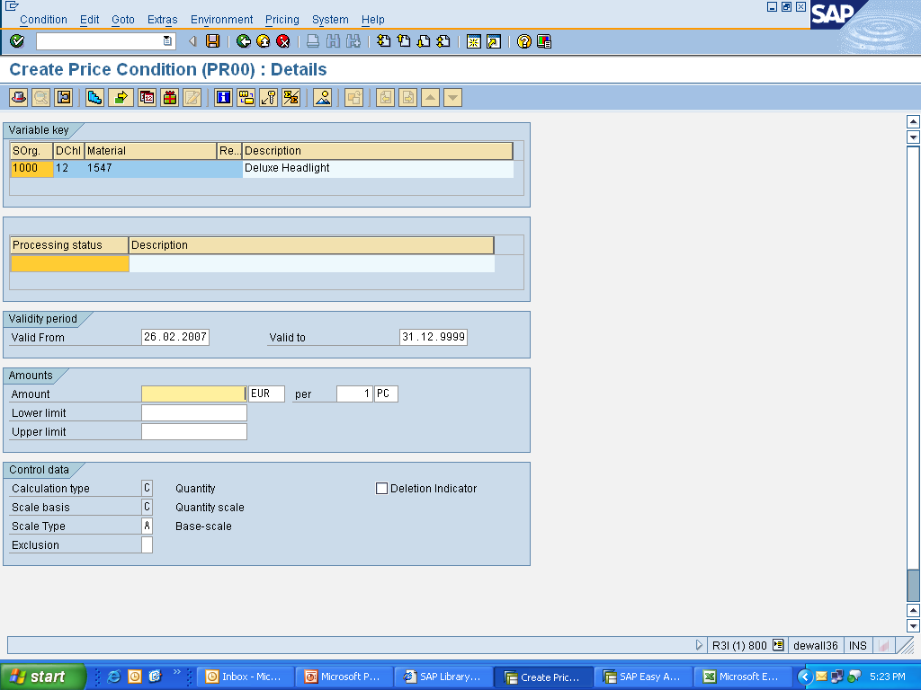
Condition Record – Create: Details
Calculation Type can be either maintained in the condition type or can be changed while creating the record if required.
Upper and lower limits helps to restrict manual changes in the sales document while pricing.

Slide 44
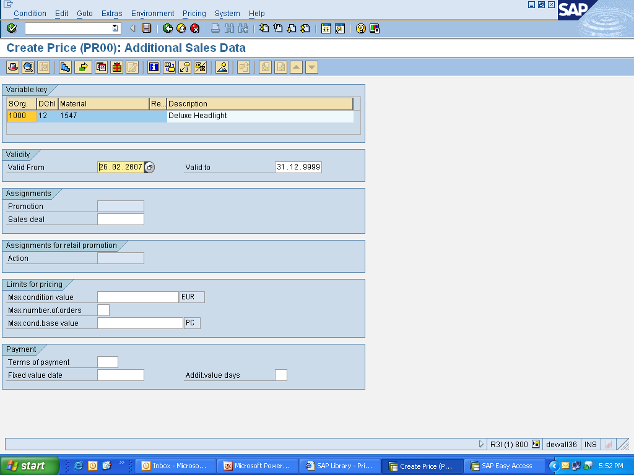
Condition Record – Create : Additional Sales Data
These fields enable to further limit the validity of the condition record until either the maximum condition value or maximum number of orders or the maximum condition base value is reached

Slide 45
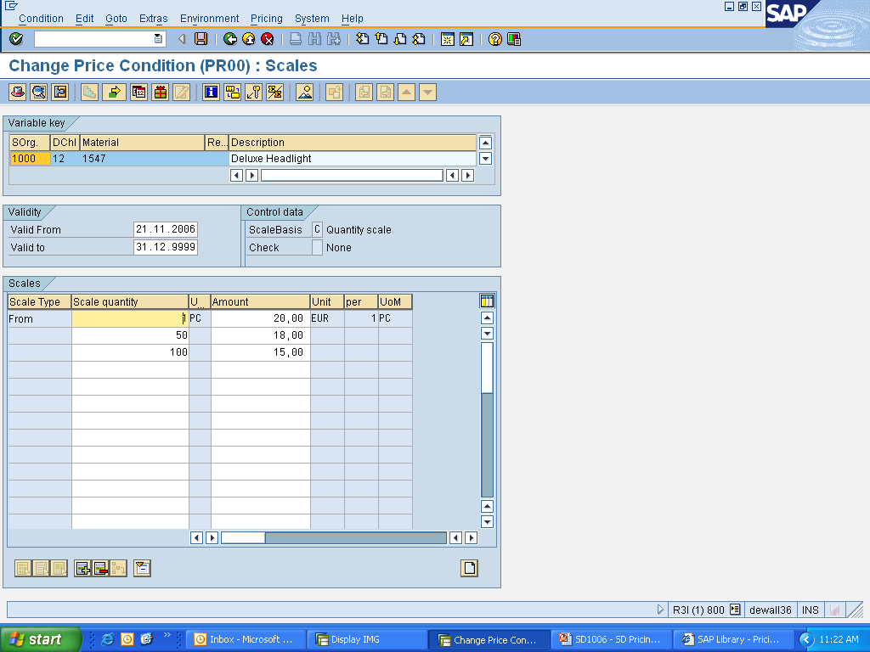
Condition Record – Create : Scales
Pricing can be varied for the pricing elements based on the scales. The scale type, scale basis are defined while customizing the condition type

Slide 46
Condition Record - Change
On any changes in the price, individual condition records can be changed manually or automatically, in case of several records
Menu Path: Easy Access →Logistics → Sales and Distribution → Master Data → Conditions → Select using Condition Type → Change (T-Code: VK12)
Condition Maintenance Menu Path: Easy Access →Logistics → Sales and Distribution → Master Data → Conditions → Change (T-Code: VK32)

Slide 47
Fiori Apps :
Create Conditions
Some Important Fiori Appps

Slide 48
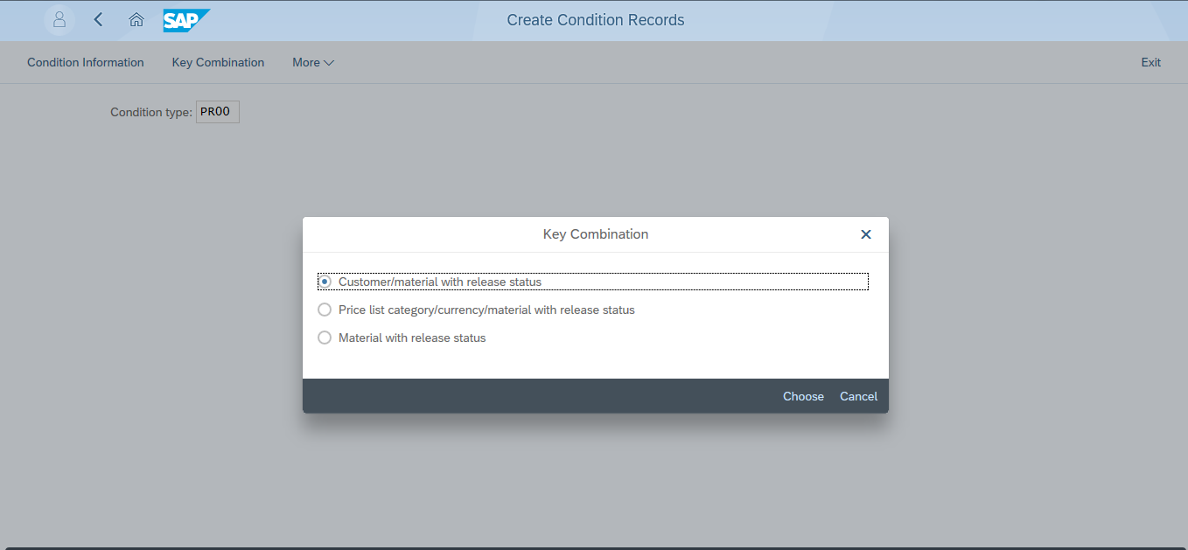
Create Conditions
1. Enter condition type
2.Choose Key combination

Slide 49
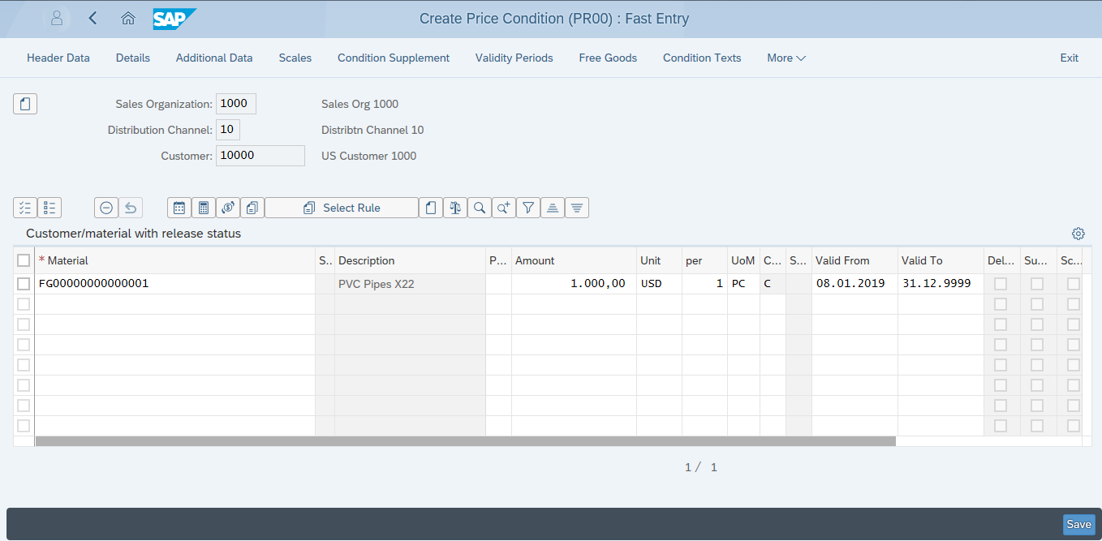
Create Conditions
1. Enter Sales Area
2.Enter Material
3.Enter Amount
4.Save

Slide 50
Transaction Codes
Use the Transaction Codes below to create Pricing Condition Technique
VOK0 | Maintain Pricing-Master Transaction
V/03 | Define Condition Tables
V/07 | Define Access Sequence
V/06 | Maintain Condition Type
V/08 | Maintain Pricing Procedure
OVKP | Define Customer Pricing Procedure
OVKI | Define Document Pricing Procedure
OVKJ | Assign Document Pricing Procedures to Order Types
OVKK | Define Pricing Procedure Determination
VK11 | Create Condition Records (Selection by condition Type)

Slide 51
Steps
Step | Input | Expected Result
1. | Call Transaction VA01 | ‘Create ZZZZ Sales Order : Initial screen’ appears
2. | Enter Order Type, Sales Organization, Distribution Channel & Division | ‘Create ZZZZ Order: Overview’ screen appears
3. | Enter Sold-to party, PO no, Material no. & Quantity | The system accepts the inputs and displays the Net Value of the order on the top.
4. | Navigate to Goto→Header→Conditions | Check prices, discounts, etc
5. | Go back and Navigate to Goto→Item→Conditions | ‘Create ZZZZ Order : Item Data’ screen appears Check prices, discounts, taxes. Also see Pricing Analysis.
6. | Select any condition type and double click | ‘Item-Condition –details’ screen appears displaying the control data and value of that condition type.
7. | Go back after save the order. | System displays the message “ ZZZZ Order XXXX has been saved”
8. | Call Transaction V/06 | ‘Change View “Conditions: Condition Types” Overview’ screen appears.

Slide 52
Steps
Step | Input | Expected Result
9. | Select the required condition type and double click. | Change View “Conditions: Condition Types” ’ screen appears.
10. | Make required changes like in Calculation Type, Scale Basis, Scale type and other allowed changes for the condition type, etc. Save the Condition Type | System displays message ‘Data was saved’
11. | Call Transaction VK11 and enter the required condition type and maintain data. | ‘Create ZZZZ Condition (Fast Entry )’ screen appears and the system accepts and saves the data entered.
12. | Repeat the steps from 1 to 6 and note the changes with the previously saved order. | Changes made in the condition type get reflected in the order and the Net Value of the order changes accordingly.

Slide 53
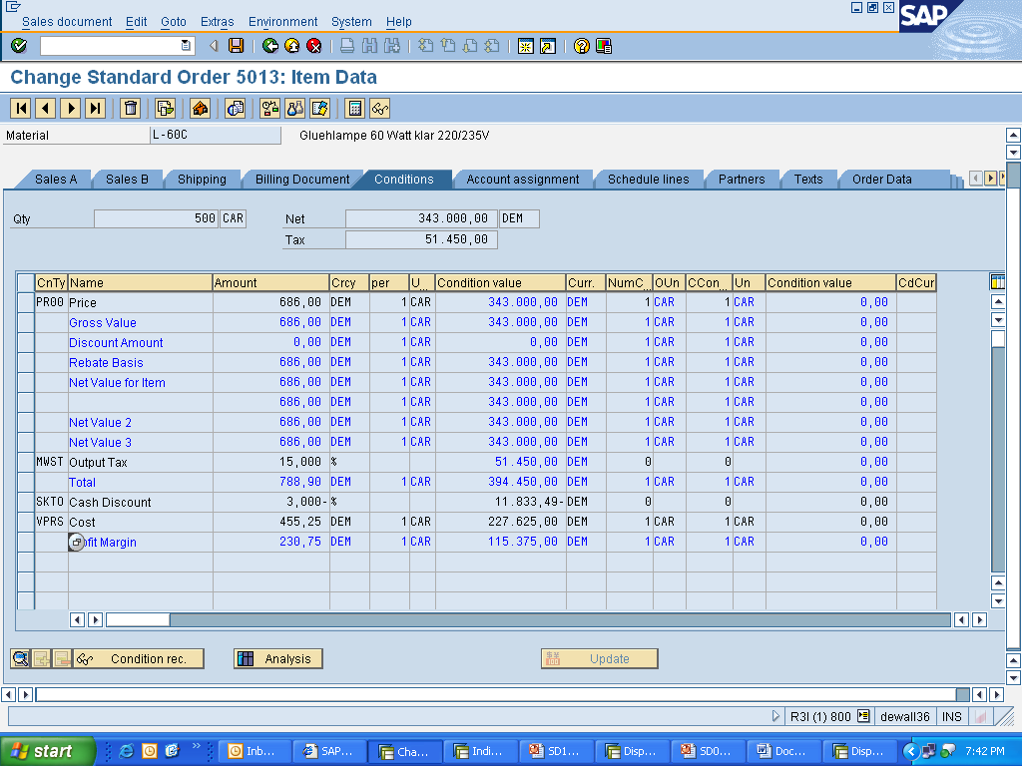
Tips and Tricks
Pricing in the sales document can be analyzed using Analysis button in the conditions overview screen at the Item level

Slide 54
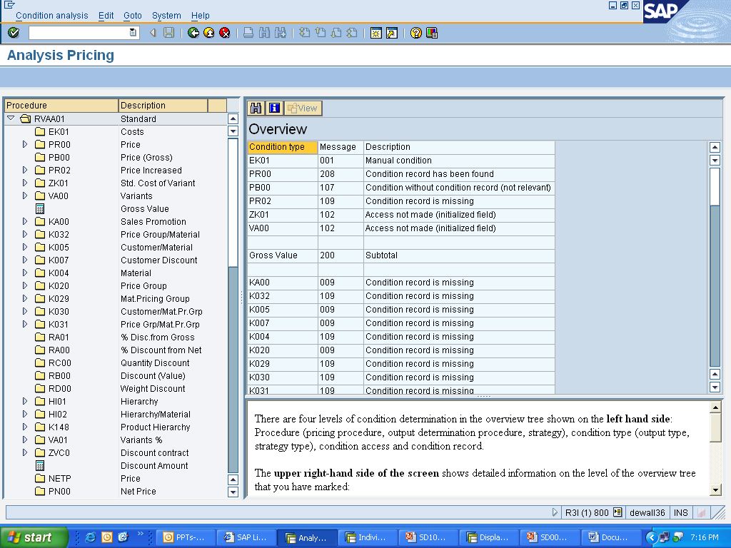
Tips and Tricks
With the help of analysis we can try to figure out how pricing has been carried out in the sales document. Analysis provides information on:
    Condition types accessed and their nature
    No of Accesses available fro each condition type
    Condition Record and their values

Slide 55
Additional Info
  Customized condition tables can be added using table numbers 501 through 999
  New header conditions can be added and changed by clicking the Activate button in the Header-> Condition overview screen
  The key fields (specific fields) of a condition table must appear at the start of the table, non-key (general) fields must not appear between any two key fields
  Use of requirements in accesses, pricing procedure avoids unnecessary accesses

